Slide 1
Data Acquisition Prototype:
Conceptual System Architecture
Phoenix
Ambulatory Blood Pressure Monitoring System
Version 0.1
© 2009 Christopher J. Adams
Copying and distribution of this document is permitted in any medium, provided this notice is preserved

Slide 2
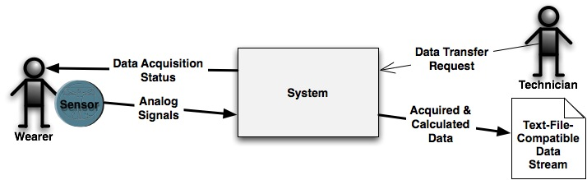
System Context

Slide 3
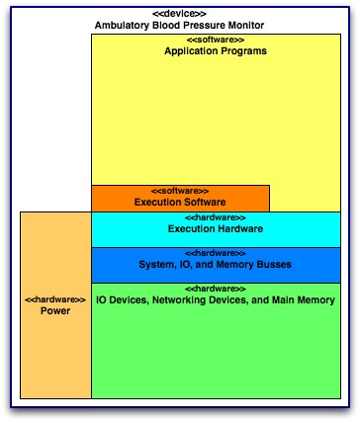
System Overview

Slide 4
Power

Slide 5
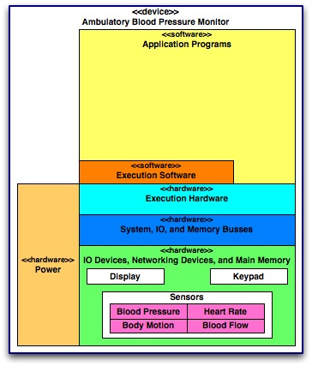
I/O Devices

Slide 6
Networking Devices

Slide 7
Main Memory

Slide 8
Bus Hardware

Slide 9
Execution Hardware

Slide 10
Execution Software

Slide 11
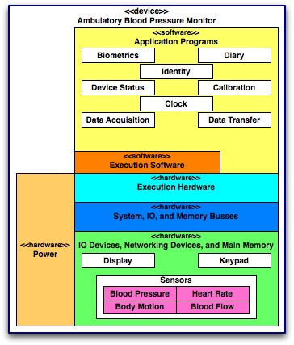
On-Board Applications

Slide 12
On-Board Applications
Clock
?

Slide 13
On-Board Applications
Identity
?

Slide 14
On-Board Applications
Data Acquisition
?

Slide 15
On-Board Applications
Device Status
?

Slide 16
On-Board Applications
Biometrics
?

Slide 17
On-Board Applications
Data Transfer
?

Slide 18
On-Board Applications
Calibration
?

Slide 19
On-Board Applications
Diary
?

